Slide 1
Team project
Context & Agreements

Slide 2
Team Project
Project one > Team Project > Industry Project > Research Project
- Project methodology: Agile Scrum
→ Work in short sprints, daily stand-ups, and deliver iterative improvements.
- Teamwork: groups of 3 students
→ This is no longer an individual project — teamwork, collaboration, and shared ownership are key.
- ‘Internal’ client: Another Howest study program
→ Communicate with your client to clarify requirements and integrate feedback
Applying knowledge from the 4 modules of semester 3 (+ previous learning from year 1)
→ We encourage you to get new knowledge and justify technical choices trough research
Goal:
  → Deliver a working proof of concept that demonstrates value for your client, with strong focus on teamwork

Slide 3
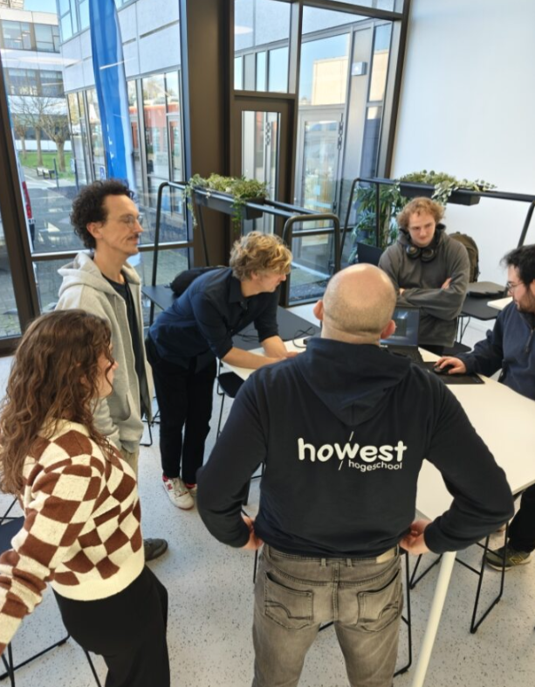
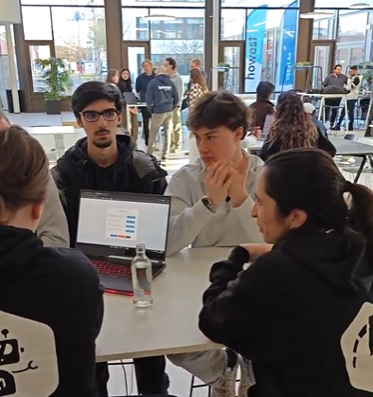

EvaluatiON team project
Introduction week presentation on Friday 7/11 (=10%)
Three full weeks in january to develop your project
                - A weekly peer-to-peer evaluation (=20%)
                - Presentation with an interim progress update and demo at the end of week 2,
                Friday 16/01: (=20%)
                - Final presentation jury on Wednesday 28/01 + quality project (= 50%)
Week 1
Week 2
Week 3
Week 4
05-09 /01
12-17 /01
19-23 /01
26-28/01
*wed 28/01 Jury

Slide 4
EvaluatiON team project
40%
60%
Interim evaluation
during project weeks
20% end week 2
20% P2P evaluation
Presentation
+ quality of the final result
10% introduction week
50% presentation + quality
No second exam opportunity is available for this project.

Slide 5
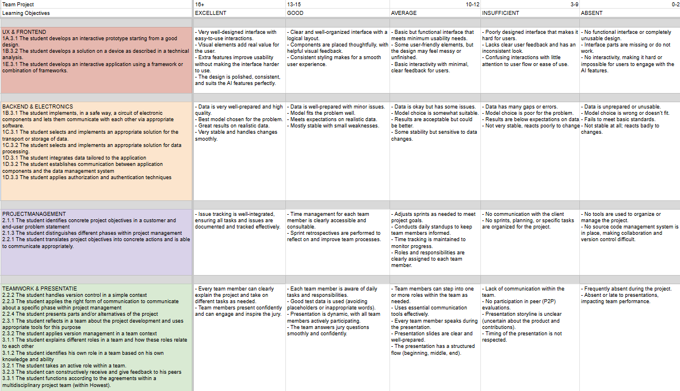
EvaluatiON team project

Slide 6
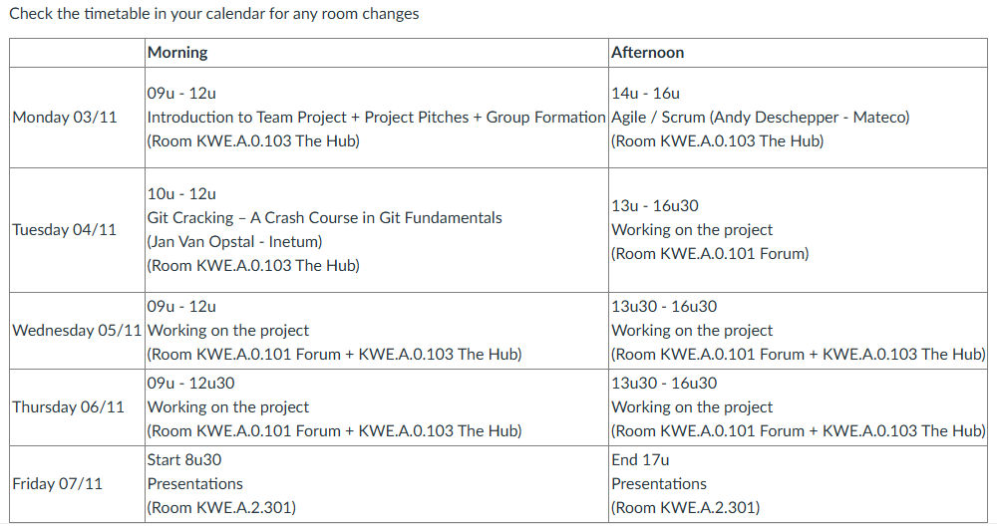
SCHEDULE INTRODUCTION WEEK

Slide 7
DELIVERABLES INTRODUCTION WEEK (06/11)
1. Written document containing (to be submitted as a PDF on Leho):
                team role distribution
                project description
                draft of the technical solution for the project (diagram + additional explanation)
                detailed description of your research for the project (with online sources and working links)
                → (for example: Are there similar use cases?, explain why you chose this approach, describe its main benefits, challenges, how it can be used, regulations? , etc)
                link to your GitHub
                link to your Trello

Slide 8
DELIVERABLES INTRODUCTION WEEK (06/11)
1. Written document containing (to be submitted as a PDF on Leho):
                Trello configuration
                - create a board and share it with the Scrum team & coaches (coaches must be able to log into your board during the presentation)
                - include a link to the board in your document
                - name the board after your project, e.g.,Ergo Group 1
                - product backlog
                - define sprints (+ prepare sprint 1 for January)
                - add tasks and assign deadlines
                - link to your GitHub

Slide 9
DELIVERABLES INTRODUCTION WEEK (06/11)
2. Presentation document containing (to be submitted as a PDF on Leho):
                project description
                team role distribution
                draft of the technical solution for the project (diagram + additional explanation)
                Trello overview (structure, backlog, sprint introduction week, January sprint prepared)

Slide 10
Presentation - Introduction Week
- When? Friday, 7 November (schedule on Leho will follow ) = 10%
- Duration? 15 minutes
- Where? A.2.302
💡 Your group should be present at the classroom 15 minutes in advance.
- Criteria?
  Documentation complete
                Quality of documentation
                Ability to explain the content of the documentation
                Presentation (appearance, everyone has a chance to speak, language use, ...)

Slide 11

COACHES
- Team of coaches with their own area of expertise
- Leho > sign up for time slots via appointment groups (calendar), not via email
Frederik Waeyaert – Backend / Cloud / General questions + Module Responsible
Marie Dewitte – AI / General questions
Wouter Gevaert – AI

Slide 12
4 pROJECTS
See Leho > Team Project > Modules > Introductionweek > Project
Evaluation system for gymnastics techniques:
Michiel Hoste - Educative Bachelor (Physical Education) - michiel.hoste@howest.be
(Michiel will be here (Forum) for the briefing tomorrow morning at 9 am)
Traffic Analysis:
Els Denaeghel - Built Environment - els.denaeghel@howest.be
(Els will be here at 10:30 am)
Energy consumption:
Jeroen Debaets - Energylab - jeroen.debaets@howest.be
Experiential learning in immersive nature:
Siska Vandemaele - Occupational Therapy - siska.vandemaele@howest.be

